Slide 1
Geography A
H070 Topic Title
H470 Topic Title

Slide 2
Guide to the SAMs
Component 2 –
The World Around Us

Slide 3
J383/02 The World Around Us
Within the study of The World Around Us learners get the opportunity to explore the complexities of the planet and the interconnections that take place.
There will be study of ecosystems of the planet, global development and the people who live on the planet, and some of the environmental challenges that the world faces.
But what will the assessments look like?
This guide will give you an understanding of the format and structure of the exam, an insight into the assessment objectives and a question by question explanation of the sample assessment for J383/02 The World Around Us. This guide can also be used with your students to support revision.

Slide 4
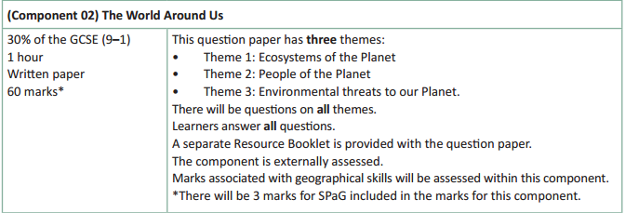
How will The World Around Us be assessed?
No optionality – students know what they need to do and will not get confused as to which option they should answer.
7 marks for AO4 (skills)
A separate Resource Booklet so students can access resources easily when answering questions.
3 marks for SPaG will be on the 12 mark question.

Slide 5
How will The World Around Us be assessed?
The exam will be 60 marks (3 of which are for SPaG) and there is 1 hour to complete the exam (a minute per mark).
The Assessment Objective breakdown for the overall paper is:
There are three sections within The World Around Us, with multi-part questions on Ecosystems of the Planet, People of the Planet and Environmental threats to our Planet.
But let’s have a look at the assessment in more detail on the following slides.
 | AO1 (Knowledge) | AO2 (Understanding) | AO3 (Application) | AO4 (Skills) | SPaG | Total
Marks | 14 | 21 | 15 | 7 | 3 | 60

Slide 6
The World Around Us
There will be one multi-part question on each of the themes studied within The World Around Us (Ecosystems of the Planet, People of the Planet and Environmental threats to our Planet) and, whilst the exact number of marks within each theme will vary year on year, there will be roughly the same number of content marks between the themes – in the sample assessment material the themes vary between 17 and 21 marks.
Each topic will start with short answer, point marked questions (1, 2, 3 and 4 mark questions) before finishing with a level of response question of either 6 mark, 8 mark or 12 marks.
Whether the theme ends with a 6 mark, 8 mark or 12 mark question will vary year on year – but there will always be one 6 mark, one 8 mark and one 12 mark question on the paper as a whole.
The 12 mark question will also have 3 SPaG marks available (total of 15 marks for question).

Slide 7
Other things to know about the assessment…
There are a few other important things to highlight for the assessment and to help you understand the mark scheme, so now we will run through:
SPaG
Quality of Extended Responses
Marking Guidance

Slide 8
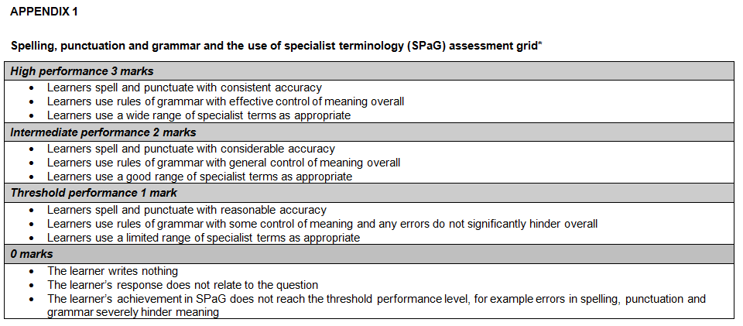
SPaG
SPaG – also known as spelling, punctuation and grammar and the use of specialist terminology – is assessed against one of the longer questions in the exam with 3 marks available. In the ‘The World Around Us’ assessment, SPaG will always be assessed on the 12 mark question.
There are clear descriptors for each level of SPaG, which are separate from the geographical content of the rest of the question. The student’s answer is read holistically and the SPaG marks are awarded on the whole answer.

Slide 9
Quality of Extended Responses
‘Quality of extended response’ is assessed within each level for questions of 8 marks or above and is indicated by an asterisk (*) beside the question. The following are the descriptors placed within the levels for 12 mark questions:
Level 4
There is a well-developed line of reasoning which is clear and logically structured. The information presented is relevant and substantiated.
Level 3
There is a line of reasoning presented with some structure. The information presented is in the most-part relevant and supported by some evidence.
Level 2
The information has some relevance and is presented with limited structure. The information is supported by limited evidence.
Level 1
The information is basic and communicated in an unstructured way. The information is supported by limited evidence and the relationship to the evidence may not be clear.
The way that a student has structured their response would need to be considered when you are deciding which level to place the student in – but the quality of the geographical content within the answer should always be the most important consideration.

Slide 10
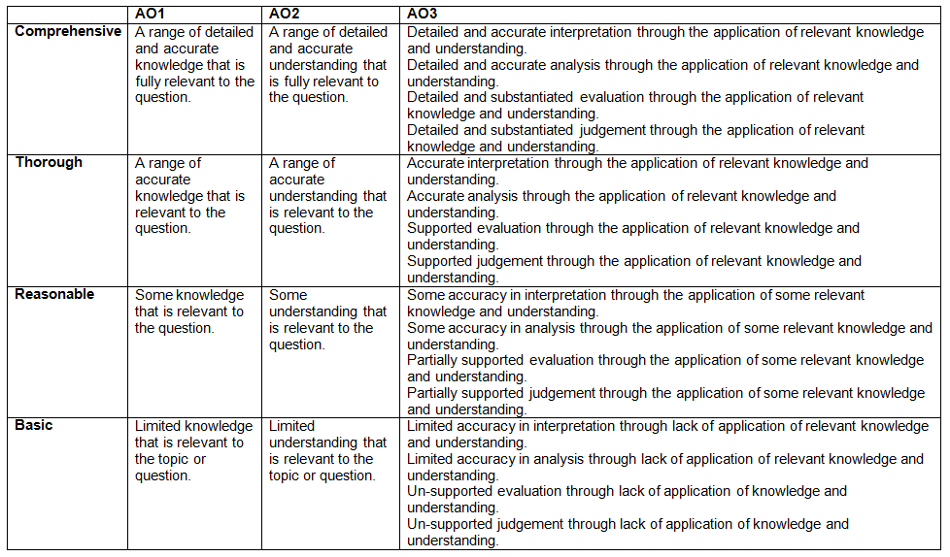
Level of Response Questions Marking Guidance
At the beginning of each mark scheme the following table is included to help you understand the level of response questions mark schemes. The wording in each level (from basic to comprehensive) indicates how answers develop and progress within each assessment objective.

Slide 11
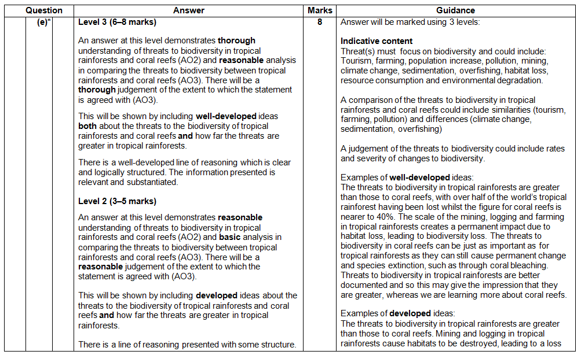
Level of Response Question Mark Scheme
The ‘Answer’ column includes information on how the assessment objectives link to the question and the standard required for the question parts.
The ‘Indicative content’ part of the mark scheme shows some of the content which could be included in students answers. This is not an exhaustive list.
A statement to indicate the level of development for answers to reach each level.
In the ‘Guidance’ column there are examples of ‘well-developed’, ‘developed’ and ‘simple’ ideas – these are examples of parts of answers – they are not full answers. The examples should show how an answer can develop from ‘simple’ to ‘developed’ to ‘well-developed’.
If ‘Quality of Extended Responses’ and/or ‘place-specific detail’ are being assessed they will be shown here.

Slide 12
Assessment Objectives
The assessment objectives are set by Ofqual and are vital to exam boards when designing assessments and for teachers in understanding styles of questions and their requirements.
For GCSE (9-1) Geography there are 4 Assessment Objectives :
AO1 (Knowledge)
AO2 (Understanding)
AO3 (Application of knowledge and understanding)
AO4 (Skills).
For all of the GCSE Geography specifications there are set assessment objectives with exact percentages of marks which must be attributed to each assessment objective within the qualification throughout the lifetime of the specification.
The next few slides will explain what the four assessment objectives mean and clarify their use in this assessment.

Slide 13
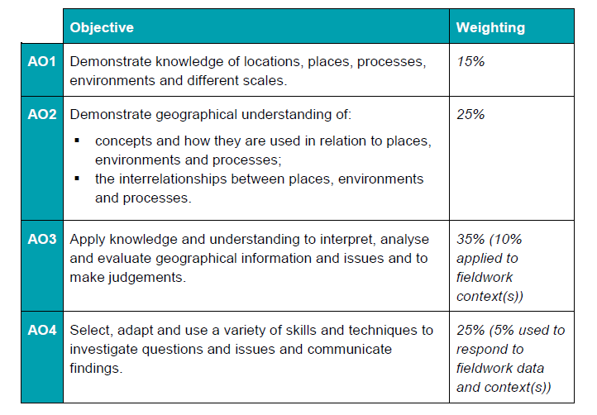
The 4 Assessment Objectives (AOs)
15% of the qualification
marks will be allocated to assessing students knowledge of the specification content (AO1)
25% of the qualification marks will be allocated to assessing students understanding of the specification content (AO2)
35% of the qualification
marks will be allocated to assessing students application of their knowledge and understanding of the specification content (AO3)
25% of the qualification
marks will be allocated to assessing students ability to select, adapt and use geographical skills and communicate findings in this context (AO4)

Slide 14
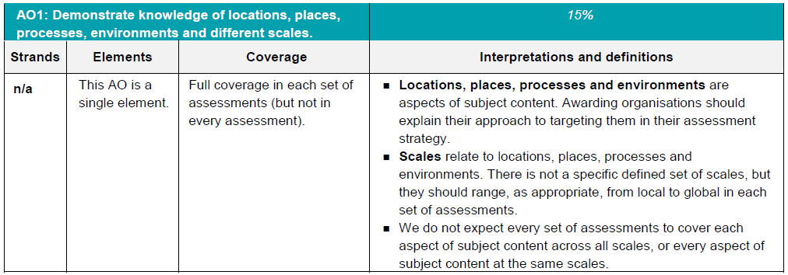
AO1 - Knowledge
Locations, places, processes and environments simply cover the subject content. There are other ways which you may describe content areas but all must be placed in these four aspects when we are creating our assessments.
Each year across the range of assessments there must be knowledge marks for locations, places, processes, environments and different scales but AO1 marks do not have to be included in every assessment.
Each year assessments will cover different scales
from local to global but not for every bit of content
or necessarily for all of locations, places, processes
and environments.

Slide 15
AO1 command words
AO1 requires candidates to demonstrate knowledge of the specification content through recalling information – including in a case study context.
Questions which target AO1 alone would tend to be shorter answer questions but longer questions may have AO1 marks allocated to them as well when combined with another assessment objective – particularly where case study information is required in an answer.
The following are some of the command words which may be used for short answer questions with AO1 marks:
Describe
Define
Outline
State
All of these command words are asking students to write down something that they have learnt from the specification and so are unlikely to be targeting a combination of assessment objectives.

Slide 16
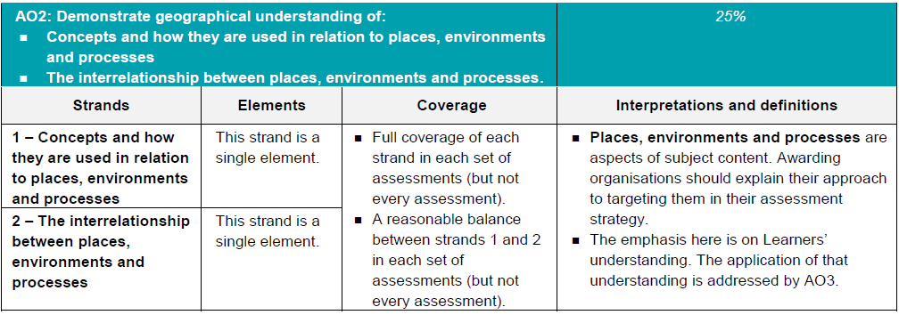
AO2 - Understanding
How concepts relate to the aspects of content.
Like with AO1 – places, processes and environments simply cover the subject content.
There must an appropriate balance in terms of the number of marks allocated to questions on the understanding of how concepts relate to content and how aspects of content relate to each other throughout the assessments.
How aspects of content relate to each other

Slide 17
AO2 command words
Questions with AO2 marks will focus on:
how concepts relate to the aspects of content
how aspects of content relate to each other
All AO2 marks will focus on understanding. AO2 marks will be directly linked to the specification but not just recalling what has been learnt, instead ensuring that students comprehend the content.
The following are some of the command words which may be used for questions with AO2 marks:
Explain how
Explain reasons/one reason
Discuss
AO2 marks may also be targeted in higher mark tariff questions but the command word may focus on a different assessment objective (e.g. AO3).
These command words may be used to solely target AO2 but may also be used in combination with other AO’s to target multiple assessment objectives, for example questions 1(d) or 2(b) of component 01 Living in the UK today.

Slide 18
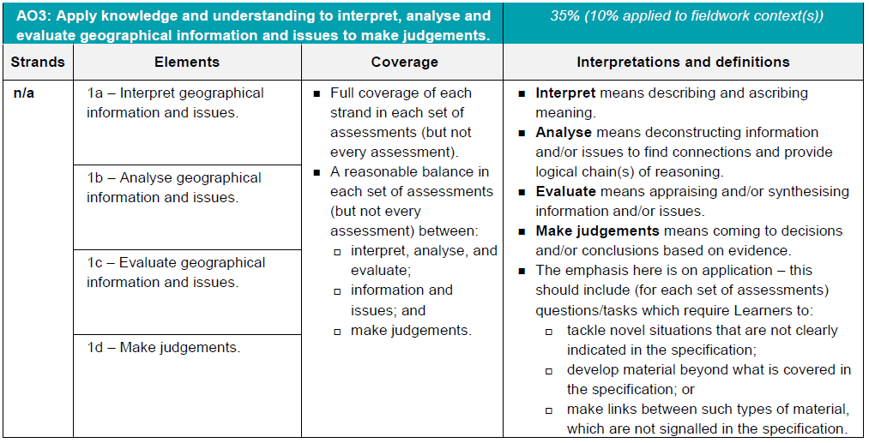
AO3 - Application
10% of the marks for the qualification must be allocated to the application of knowledge and understanding in a fieldwork context.
Three ways that students will need to apply their knowledge and understanding:
‘tackle novel situations’ could mean applying knowledge and understanding to a resource
‘developing material beyond the specification’ could be evaluating the success of a management strategy when the specification doesn’t explicitly ask for that
‘making links between such types of material which are not signalled in the specification’ could be synoptic questions.

Slide 19
AO3 command words
Command words will vary depending on whether students are applying their knowledge and understanding by interacting with a resource(s) or not.
The following are some of the command words which may be used for questions with AO3 marks:
Weigh up whether a statement is true.
Interacting with resource | No resource
Describe | Assess
Give | Examine
Suggest | Evaluate
Outline | To what extent do you agree
Look in close detail and establish the key facts and important issues.
Give your verdict after providing evidence which both agrees with and contradicts an argument.
How much you agree with a statement based on the evidence in the argument.

Slide 20
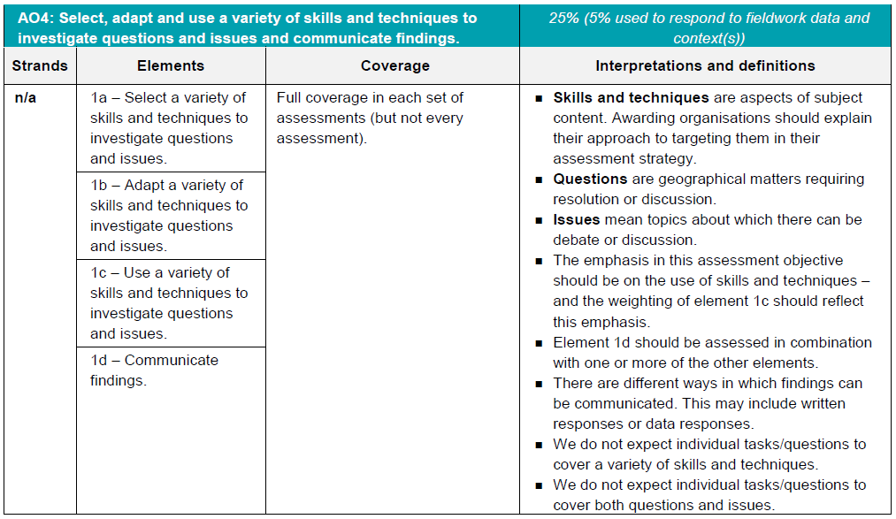
AO4 - Skills
5% of the marks for the qualification must be allocated to geographical skills in a fieldwork context.
Most of the AO4 marks will be allocated to using geographical skills – however there must be marks targeting ‘questions’ and ‘issues’ for selecting skills, adapting skills and using skills, as well as marks targeting ‘communicating findings’.

Slide 21
AO4 command words
AO4 requires students to select, adapt and use geographical skills, as well as communicate findings.
The following are some of the command words which may be used for questions with AO4 marks:
Describe the pattern
Using data
Calculate
Identify
Make a prediction
Commands words may vary depending on the level of interaction with a resource.

Slide 22
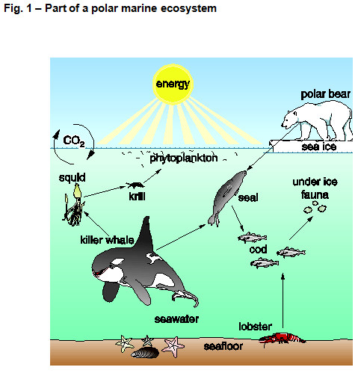
Question 1(a)
Study Fig. 1, a diagram showing part of a polar marine ecosystem.
Questions will refer to the diagram in Fig. 1 and could be on any aspect at the moment, students should read the question first so they know what to focus on.

Slide 23
Question 1(a)(i) – 2 mark
Describe how the cod, seal and polar bear shown in Fig. 1 are connected in this ecosystem.
This question is an AO3 (application) question as students need to apply their knowledge and understanding to the unseen resource. Therefore students are tackling a novel situation – one of the three ways application (AO3) must be assessed – within their answer to this question.
There are 2 marks – 1 mark for each valid description of how the cod, seal and polar bear are connected in this ecosystem.
Any appropriate answer should be credited and the mark scheme gives a couple of different examples of how students could get marks, including:
seal will eat the cod (✓)
polar bear will eat the seal (✓)
connected by the food chain/web (✓) + example (✓)

Slide 24
Question 1(a)(ii) – 1 mark
Which of the following is a biotic component in the polar marine ecosystem shown in Fig.1?
A carbon dioxide
B phytoplankton
C seafloor
D sun’s energy
This is an AO3 (application) multiple choice question. Students need to apply their knowledge and understanding of biotic ecosystem components in order to interpret which of the four choices from the resource is a biotic component.
Once again students are tackling a novel situation from this unseen resource and so this is an application (AO3) question.
The answer is ‘B: Phytoplankton’ as the other three options are abiotic components of the ecosystem.

Slide 25
Question 1(b) – 3 marks
Describe the climate found in tropical savannah grassland ecosystems.
This is an AO1 (knowledge) question as students need to recall the climate found in tropical savannah grassland ecosystems. There are 3 marks available so three valid points about the climate found in tropical savannah grassland ecosystems are required. No explanation of the climate found is necessary hence why this is AO1 (knowledge) and not AO2 (understanding).
Examples of potential answers in the mark scheme:
Extremely low rainfall November – March (✓)
Heavy rains July – Sept (✓)
High temperatures particularly March – October (✓)
Highest temperatures before heavy rains (✓)
Coolest period just after heavy rains (✓)

Slide 26
Question 1(c) – 1 mark
The Amazon Rainforest in Brazil experiences deforestation. Between 2012 and 2013
6 000 km² of rainforest was cleared. In two Brazilian states there was a combined total of 2 400 km² of rainforest cleared between 2012 and 2013.
Calculate the percentage of rainforest cleared in the two states out of the total rainforest lost between 2012 and 2013.
This is an AO4 (skills) question requiring students to use their skill of calculating and understanding percentages. The data is contextualised through information on tropical rainforest deforestation.
Students need to work out what percentage 2400 is out of 6000. This can be done in a number of ways and it is important to remember that students can use a calculator in all of their GCSE (9-1) Geography exams – and so may want to take one in .
The answer is 40% and they do not need to show working in their answer as it is not asked for.

Slide 27
Question 1(d) – 4 marks
Explain how nutrients are recycled in the tropical rainforest.
This is an AO2 (understanding) question. Within the specification students are required to learn about ‘the processes that operate within tropical rainforests, including nutrient and water cycles’, but this question asks for an explanation of how nutrients are recycled in the tropical rainforest. It requires understanding to explain how nutrients are recycled rather than just recalling the process.
There are four marks – one mark for each valid explanation point of how nutrients are recycled in the tropical rainforest. The mark scheme is below (although the wording would not have to be exactly the same):
Leaves fall from trees and decay on rainforest floor due to warm moist conditions (✓)
Fungi and bacteria decompose organic matter which forms humus (✓)
Nutrients enter the rainforest soil and they are dissolved by rain (✓)
Nutrients taken up by shallow tree and plant roots helping rapid growth (✓)

Slide 28
Question 1(e)* – 8 marks
‘Tropical rainforests experience greater threats to their biodiversity than coral reefs.’
To what extent do you agree with this statement?
An 8 mark question which is split between AO2 (understanding) and AO3 (application).
This question has marks for AO2 for understanding the threats to biodiversity in tropical rainforests and coral reefs and for AO3 (application) – for both analysis (comparing the threats to biodiversity between tropical rainforests and coral reefs) and for a judgement (the extent to which the statement is agreed with).
This question requires students to make links between types of material which are not signalled in the specification – one of the three ways we must assess application over the course of a set of assessments. As the two case studies are separate then you would not necessarily expect them to be assessed together, which is why application of knowledge and understanding is required.
The asterisk (*) shows that ‘Quality of extended response’ will be assessed in this question – you can find out more about the Quality of Extended Response descriptors on slide 9.

Slide 29
Question 1(e)* – The mark scheme
Level 3 (6–8 marks)
An answer at this level demonstrates thorough understanding of threats to biodiversity in tropical rainforests and coral reefs (AO2) and reasonable analysis in comparing the threats to biodiversity between tropical rainforests and coral reefs (AO3). There will be a thorough judgement of the extent to which the statement is agreed with (AO3).
This will be shown by including well-developed ideas both about the threats to the biodiversity of tropical rainforests and coral reefs and how far the threats are greater in tropical rainforests.
Level 2 (3–5 marks) looks for the same focuses in answers but with reasonable understanding and judgement but only basic analysis through developed ideas.
Level 1 (1–2 marks) looks for the same focuses in answers but with basic understanding and judgement through simple ideas but no analysis.
‘Quality of extended response’ is assessed within each level – you can find out more about the Quality of Extended Response descriptors on slide 9.

Slide 30
Question 1(e)* – The mark scheme
Threats must focus on biodiversity and could include (for example) tourism, farming, population increase, pollution, mining, climate change, sedimentation, overfishing, habitat loss, resource consumption and environmental degradation – but any threat to biodiversity could be included. Comparisons of the threats could include similarities (e.g. tourism, farming, pollution) and differences (e.g. climate change, sedimentation, overfishing) could be discussed, and the judgement element could include discussion of rates and severity of changes to biodiversity.
Examples of well-developed ideas:
The threats to biodiversity in tropical rainforests are greater than those to coral reefs, with over half of the world’s tropical rainforest having been lost whilst the figure for coral reefs is nearer to 40%. The scale of the mining, logging and farming in tropical rainforests creates a permanent impact due to habitat loss, leading to biodiversity loss. The threats to biodiversity in coral reefs can be just as important as for tropical rainforests as they can still cause permanent change and species extinction, such as through coral bleaching.
Threats to biodiversity in tropical rainforests are better documented and so this may give the impression that they are greater, whereas we are learning more about coral reefs.
This well-developed idea integrates understanding of the threats to biodiversity with comments comparing the threats to coral reefs and tropical rainforests – as well as including comments reflecting a judgement as to the extent that the statement is agreed with.

Slide 31
Question 2(a)(i) – 1 mark
Which of the following development indicators is used as part of the HDI calculation?
A Birth rate per 1000 people per year
B Infant mortality rate
C Internet users
D Life expectancy at birth
This is an AO1 (knowledge) question as the Human Development Index (HDI) is in the specification (spec ref 2.2.1) – and in the specification it follows the word ‘including’ meaning that it is not just an example (which would follow ‘such as’) but is something we might assess directly.
The HDI indicators are life expectancy at birth, mean years of schooling, expected years of schooling and GNI per capita. Therefore ‘D: Life expectancy at birth’ is the correct answer, with the other three potential answers being development indicators, just not part of the HDI calculation.

Slide 32
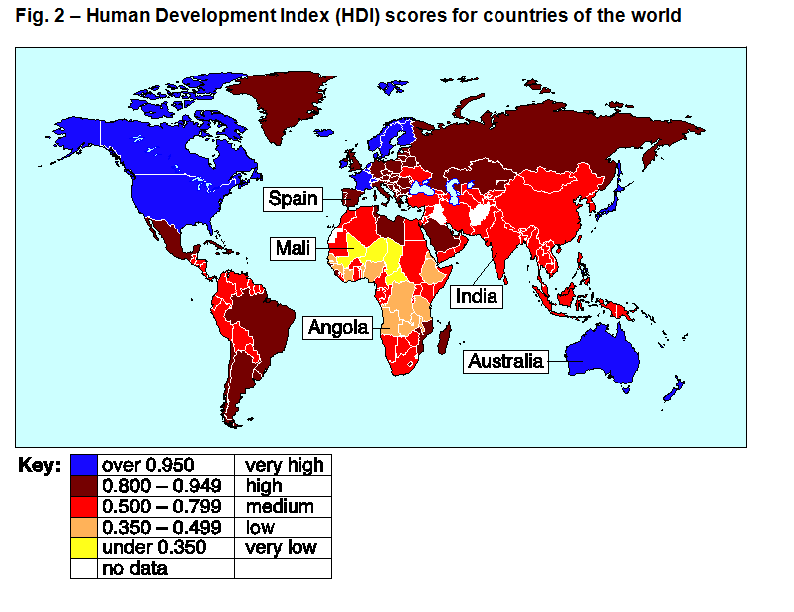
Question 2(a)(ii) – 3 mark
Using Fig. 2, describe the pattern of HDI scores for countries of the world.
This is an AO4 (skills) question where students need to describe the pattern shown. This is a three mark ‘describing the pattern’ question, so there will be a mark for the order that the answer is written (communicating findings). That leaves two marks for describing the pattern. Students need to make two points to describe the data and put the two points in the most logical order. Make sure students take a couple of seconds to think about their two points before putting pen to paper, it should help them get the communicate findings mark.
In the mark scheme example, the two marks for describing the pattern are indicated with a tick.
The mark for communicating the answer in an appropriate and logical order (COM) is shown last – but that is because that is just where the answer finishes. The mark is specifically awarded because the general pattern is given first and then a specific point about the pattern is made afterwards.
Examples of this are shown on the next slide.

Slide 33
Question 2(a)(ii)– The mark scheme examples
General pattern
Specific part of pattern
There is an uneven spread of HDI across the world (✓) with four continents which have countries with very high HDI scores (✓) (COM)
Overall answer looked at – mark awarded as the general pattern is given first and then a specific point about the pattern is made afterwards.
There is an uneven spread of HDI across the world (✓) with Africa the only continent with the lowest HDI scores (✓) (COM)
General pattern
Specific part of pattern

Slide 34
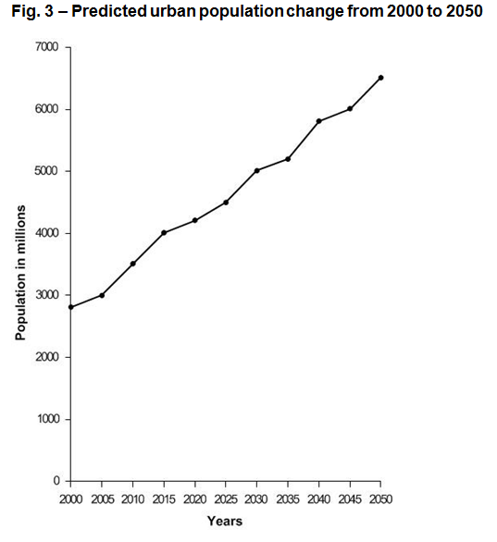
Question 2(b)(i) – 1 marks
Using Fig. 3, calculate the percentage increase of the predicted urban population between 2015 and 2050.
This is a 1 mark AO4 (skills) question where students need to use their numerical and statistical skills to calculate the percentage increase.
To calculate the percentage increase, you need to work out the difference between the two numbers, divide by the original and then multiply by 100 (so it becomes a percentage).
Here we need the difference between the predicted urban population in 2015 and 2050. The figure for 2015 is 4000 and for 2050 is 6500. The difference is therefore 2500. 2500 divided by 4000 is 0.625 and if you multiply this by 100 you get 62.5%.
Remember, students can take calculators into the exams and there are no marks for showing the working out for this question.

Slide 35
Question 2(b)(ii) – 4 marks
There are a number of push and pull factors that cause rapid urbanisation in low-income developing countries (LIDCs).
Explain how two push factors cause rapid urbanisation in LIDCs.
This question has 2 marks for AO1 (knowledge) and 2 marks for AO2 (understanding). Students will learn about ‘the causes of rapid urbanisation in LIDCs including push and pull factors’ from the specification and so should know two push factors that cause rapid urbanisation in LIDCs – so this is knowledge of the content (AO1). However, to be able to explain the push factors requires an understanding of the content (AO2).
Few opportunities for education (✓) encouraging people to move to give their children opportunities (DEV)
There are 2 marks for identifying push factors (✓) (recalling this from their study) and 2 marks for explaining how push factors cause rapid urbanisation (DEV) (showing their understanding of this from their study).
People need to find work (✓) so there’s an increased demand for informal jobs to support their families (DEV)
Poor standard of living in rural areas (✓) and government investment in urban areas encourages population movement on a larger scale (DEV)
Natural hazards such as drought or flooding (✓) encourage more people to move to urban areas in search of work and shelter (DEV)
Mechanisation of farming encourages people to move to urban areas (✓) leading to the building of housing or growth of shanty towns (DEV)

Slide 36
Question 2(c)* – 12 marks (+3 SPaG)
Examine how far migration influences the growth and character of cities in LIDCs or EDCs.
Use case study knowledge in your answer.
This is a 12 mark question which is split evenly between AO1 (knowledge), AO2 (understanding) and AO3 (application).
The question asks for students to use case study knowledge in their answer – and so this automatically means that there will be AO1 (knowledge) marks. The question includes ‘migration’ and ‘growth and character of cities’ which are both conceptual and require understanding (AO2). The command of ‘Examine how far’ indicates that application (AO3) will be required as students will need to develop their answer beyond what they have learnt in the specification.
In the specification students will have learnt about the ‘influence of migration (national and international) and its impact on the city’s growth and character’ for one LIDC or EDC city. As the question asks for students to examine how far migration influences the growth and character of cities in LIDCs and EDCs, students could discuss how migration influences the growth and character of cities in LIDCs and EDCs, the degree of this, other influences and potentially generalisations from the case study to other cities.
The asterisk (*) shows that ‘Quality of extended response’ will be assessed in this question – you can find out more about the Quality of Extended Response descriptors on slide 9.
There are marks for SPaG (Spelling, punctuation and grammar and the use of specialist terminology) you can find out more about the SPaG descriptors on slide 8.

Slide 37
Question 2(c)* – The mark scheme
Level 4 (10–12 marks)
An answer at this level demonstrates comprehensive knowledge of how migration influences the growth and character of cities (AO1) and comprehensive understanding of the concepts of migration and growth and character of cities (AO2). There will be a comprehensive evaluation of how far migration influences the growth and character of cities (AO3).
This will be shown by including well-developed ideas about the concepts of migration and growth and character in the cities and how migration influences the growth and character of cities.
The answer must also include place-specific details for the named LIDC/EDC city.
Level 3 (7–9 marks) looks for the same focuses in answers but with thorough knowledge, understanding and evaluation through well-developed ideas about either concepts of migration and growth and character in the cities or how migration influences the growth and character of cities and developed ideas about the other question focus. The answer must also include place-specific details of the named LIDC/EDC city.
Level 2 (4–6 marks) looks for the same focuses in answers but with reasonable knowledge, understanding and evaluation through developed ideas about either concepts of migration and growth and character in the cities or how migration influences the growth and character of cities and simple ideas about the other question focus. The answer must also include named details within the LIDC/EDC city.
Level 1 (1–3 marks) looks for the same focuses in answers but with basic knowledge, understanding and evaluation through simple ideas about either concepts of migration and growth and character in the cities or how migration influences the growth and character of cities. The answer must also include a named city within the LIDC/EDC.
‘Quality of extended response’ is assessed within each level – you can find out more about the Quality of Extended Response descriptors on slide 9.

Slide 38
Question 2(c)* – The mark scheme
The answer will very much depend on upon the named major city studied and migration could be discussed in terms of rural to urban, urban to urban or international. Ideas regarding the influence of migration on the city’s growth and character could include:
changes to the cities growth such as increased demand for housing
infrastructure investment and building as well as demand for services
impacts on the character of the city through architecture, housing, inequalities, consumerism and gentrification
globalisation of jobs, services and leisure activities
increased evidence of traffic congestion, pollution
increased commuting and waste generated
impacts on the character of the city through
languages spoken, cultural activities and types of food
Examples of well-developed ideas:
The city of Shanghai has experienced significant population growth. In 2000 the city was 16.4 million people, by 2010 it was 23 million. Shanghai shows how high rates of internal and international migration can influence the cities growth. It has continued to grow and covers approximately 2,500sq miles, expanding east of the river in the 1990s, this area is called Pudong New District. Shanghai has high population densities at 120,000 people km² and it continues to receive migrants as it has become an economic, financial and trade centre. The character of the city has become increasingly modern, congested and polluted as it continues to grow into the suburbs.
For the city of Shanghai migration is heavily influencing the growth of the city through the fast pace of house building and transport links and the character is changing gradually over time through redevelopment and international influences particularly through industry, services and retail. The local government are keen to show Shanghai’s past so Shikumen houses are being preserved and these are used for cottage industries and boutique shops.
This well-developed idea integrates knowledge, understanding and application of the knowledge and understanding of how migration influences growth in character in cities, the concepts of migration and growth and character in cities and an examination into how far migration influences growth and character in cities.

Slide 39
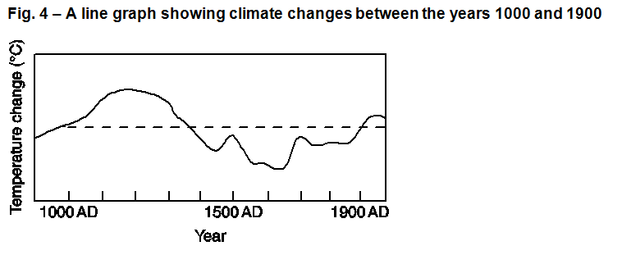
Question 3(a) – 1 mark
Study Fig. 4, a line graph showing climate changes between the years 1000 and 1900.
Which of these years was in the medieval warm period?
A 1200
B 1500
C 1700
D 1900
This is an AO4 (skills) question where students need to interpret the graph in order choose the correct answer for when the medieval warm period was.
The correct answer is ‘A: 1200’, which is the period with the warmest period on the graph.

Slide 40
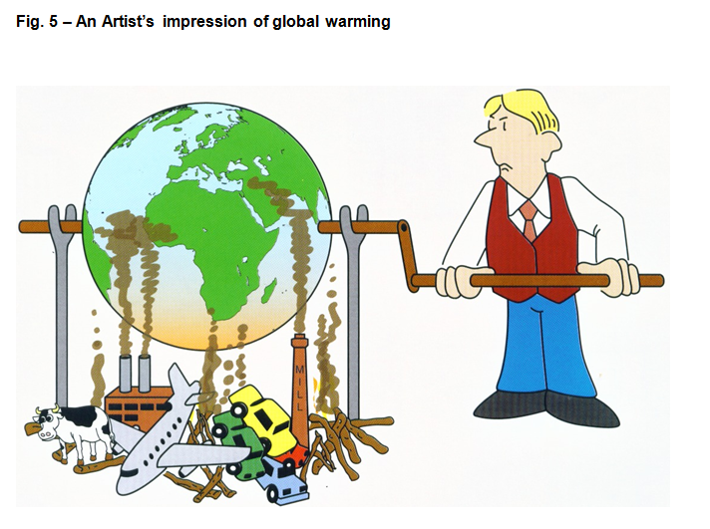
Question 3(b) – 4 marks
Study Fig. 5, a cartoon showing an artist’s impression of global warming.
Using evidence from Fig. 5, explain how human activity creates the enhanced greenhouse effect.
This question has 4 marks in total with 1 AO3 (application) mark for interpreting the cartoon and identifying evidence from Fig. 5 with 3 marks for AO2 (understanding) for the explanation of how human activity creates the enhanced greenhouse effect based on the evidence interpreted.
Evidence from Fig. 5 could include cattle farming (✓), burning fossil fuels/coal fired power station (✓), transport/car/air travel (✓), deforestation/burning wood (✓)
Example answer:
Industrial growth (✓) has led to burning fossil fuels and so more carbon dioxide is produced (DEV), the gas enters the atmosphere and traps solar radiation (DEV) enhancing the greenhouse effect so that the world gets warmer (DEV).

Slide 41
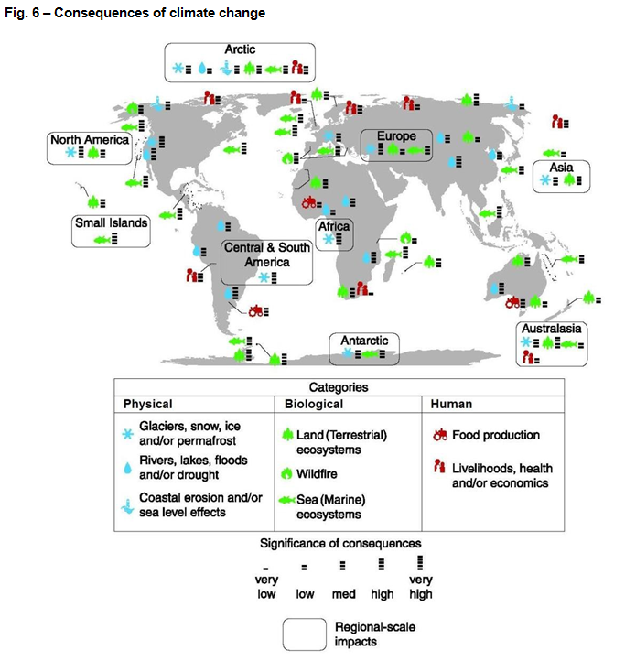
Question 3(c) – 2 mark
Study Fig. 6, a map showing the consequences of climate change split into three categories (physical, biological and human).
Using Fig. 6, state which category has been affected most by the consequences of climate change. Give a reason for your answer.
This AO3 (application) question requires students to apply their knowledge and understanding to the resource (a map showing the consequences of climate change) to make a judgement as to which category has been affected most by the consequences of climate change (✓) and to give one reason for the answer by analysing the resource (DEV).
Potential answers could include (but are not restricted to):
Biological category has been affected most (✓) because this is the category that has the most recorded evidence shown on the map (DEV)
Biological category has been affected most (✓) because the height of the bars on the map indicate that this category has worse consequences than physical or human categories (DEV)

Slide 42
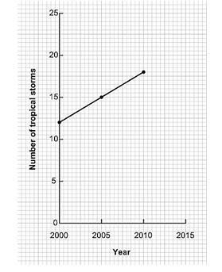
Question 3(d) – 1 mark
Using the graph above, make a prediction for the number of tropical storms globally in 2015.
The geographical skill (AO4) assessed is the ability to make predictions from data.
The number of tropical storms are increasing on the graph by 3 every five years and so the most logical prediction to make is that they continue in the same manner with no evidence to suggest the pattern will change.
The answer therefore is 21.

Slide 43
Question 3(e) – 3 marks
Explain the distribution of tropical storms and whether this has changed over time.
This question has 1 mark for AO1 (knowledge) and 2 marks for AO2 (understanding). The knowledge mark is for giving the distribution of tropical storms (✓) with the explanation of whether the distribution of tropical storms has changed over time requiring the understanding (DEV).
Examples of potential answers in the mark scheme:
Close to the equator (✓)
Between 30 degrees North and South of the equator (✓)
Atlantic hurricanes have increased since 1995 due to sea surface temperature changes (DEV)
Over the last 30 years El Niño and variations in monsoons have influenced tropical storm tracks and their distributions (DEV)
There has not been significant changes to distributions of tropical storms (DEV) with storms occurring in the same areas of the world but with changes in the distributions regionally (DEV)

Slide 44
Question 3(f) – 6 marks
CASE STUDY – Drought caused by El Niño/La Niña
Drought studied:
Explain how El Niño/La Niña leads to drought in your case study area.
This question is split evenly between AO1 (knowledge) and AO2 (understanding) marks.
As part of the specification students will study a case study of one drought caused by El Niño/La Niña including ‘how the extreme weather conditions of El Niño/La Niña develop and can lead to drought’. Therefore for students to be able to explain how El Niño/La Niña leads to drought in their case study area they must show that they understand (AO2) this part of the content including El Niño/La Niña. As it is a case study there will be AO1 marks (knowledge).

Slide 45
Question 3(f) – The mark scheme
Level 3 (5–6 marks)
An answer at this level demonstrates thorough understanding of the concept of El Niño/La Niña (AO2) and thorough knowledge of how this can lead to drought in the case study area (AO1).
This will be shown by including well-developed ideas about both the concept of El Niño/La Niña and how this can lead to drought.
The answer must also include place-specific details of the drought area. Amount of relevant place-specific detail determines credit within level.
Level 2 (3–4 marks) looks for the same focus in answers but with reasonable understanding through developed ideas about either the concept of El Niño/La Niña or how this can lead to drought. Answers with no place-specific detail are credited up to the middle of the level.
Level 1 (1–2 marks) looks for the same focus in answers but with basic understanding through simple ideas about the concept of El Niño/La Niña or how this can lead to drought. Simple ideas or appropriate named example only credited at bottom of level.
The mark scheme also states that the example stated must be linked to either El Niño or La Niña and how this leads to drought.

Slide 46
Question 3(f) – Indicative Content
Ideas for El Niño could include:
Warm and cold air circulating in the Pacific Ocean
Reversal in normal winter ocean current patterns
This leads to changes in the circulating cold and warm water
There are changes in atmospheric processes over the Pacific Ocean (winds blow in opposite direction to normal)
Places like Australia suffer drought as the winds that normally bring rain change direction from west to east and bring much drier weather
This happens every 3-7 years although the frequency is increasing
Ideas for La Niña could include:
Warm and cold air circulating in the Pacific Ocean
Below normal cooling of sea surface temperatures in eastern tropical Pacific Ocean
There are changes in atmospheric processes over the Pacific Ocean (the eastward trade winds strengthen, with the pattern a more intense version of normal conditions)
La Niña characterised by higher than normal pressure over central and eastern Pacific. This results in decreased cloud production and rainfall in that region
Drier than normal conditions are observed along the west coast of tropical South America and the Gulf Coast of the United States, which can lead to drought

Slide 47
Question 3(f) – Well-developed? Developed? Simple?
Examples of simple ideas:
Australia is very dry once every 5–7 years, this is happening more.
There was no rain between 2005 and 2007.
The winds changed direction and didn’t bring rain so the east coast was very dry.
Examples of developed ideas:
Australia is influenced by El Niño once every 5–7 years, this caused drought from 2005-2007. The winds usually blow east to west but El Niño caused them to blow the opposite way. By the time they reach the east coast they are very dry and bring drought conditions to the south east.
Examples of well-developed ideas:
Australia is influenced by El Niño once every 5–7 years, although this is becoming more frequent. El Niño caused drought from 2005-2007. The trade winds usually blow east to west but El Niño caused them to blow the opposite way and so by the time they reach the east coast they are very dry and bring drought conditions to areas like New South Wales.
This slide shows how ideas may progress from simple to developed and then well-developed.

Slide 48
We’d like to know your view on the resources we produce. By clicking on ‘Like’ or ‘Dislike’ you can help us to ensure that our resources work for you. When the email template pops up please add additional comments if you wish and then just click ‘Send’. Thank you.
Whether you already offer OCR qualifications, are new to OCR, or are considering switching from your current provider/awarding organisation, you can request more information by completing the Expression of Interest form which can be found here: www.ocr.org.uk/expression-of-interest
Looking for a resource? There is now a quick and easy search tool to help find free resources for your qualification: www.ocr.org.uk/i-want-to/find-resources/
OCR Resources: the small print OCR’s resources are provided to support the delivery of OCR qualifications, but in no way constitute an endorsed teaching method that is required by the Board, and the decision to use them lies with the individual teacher. Whilst every effort is made to ensure the accuracy of the content, OCR cannot be held responsible for any errors or omissions within these resources. © OCR 2017 - This resource may be freely copied and distributed, as long as the OCR logo and this message remain intact and OCR is acknowledged as the originator of this work.
OCR acknowledges the use of the following content: n/a
Please get in touch if you want to discuss the accessibility of resources we offer to support delivery of our qualifications: resources.feedback@ocr.org.uk

